Slide 1




Personal Desktop voice assistant using python
FRIDAY
SDC Internship Project

Slide 2
Team Members
Abhinav Lakshmi Majeti 1MJ21CS003
Gokul Naga Satvik Kakumanu 1MJ21CG025
Rahul Mishra 1MJ21CS170
U Giridharan 1MJ21CS233

Slide 3

Introduction
With the current trend of AI seemingly having a boom and everything being voice controlled becoming more common than ever, this project focuses on implementing a personal desktop voice assistant to make trivial tasks all the more easier. We call it FRIDAY.

Slide 4




FEATURES
It has a login system. The voice assistant is only activated after the login is successful
Greets the user according to the time of the day
Can search anything in Wikipedia and Google
Can open websites like GitHub, Spotify, Stack Overflow, etc.
Can search any location on Google Maps

Slide 5


- Can send automated WhatsApp message to any mobile phone number
- Can tell random jokes
- Can tell the weather of any city in the world
Can read and display the current news
- It has a dedicated To-Do list/Memo

Slide 6

Hardware requirements
Language Used: Python
Minimum specs:
• Processors: Intel Atom processor or Intel Core i3 processor
• RAM: At least 2 GB
• Disk space: 1 GB
• Operating systems: Windows* 7 or later, macOS, and Linux
• Python versions: 2.7.X, 3.6.X
• Must have a functional Microphone
• Internet Connection
• IDE: Visual Studio Code, PyCharm

Slide 7

Python Modules used in project
Pyttsx3:
It is a text-to-speech conversion library in Python. Unlike alternative libraries, it works offline, and is compatible with both Python 2 and 3.
speechRecognition:
Library for performing speech recognition, with support for several engines and APIs, online and offline.

Slide 8
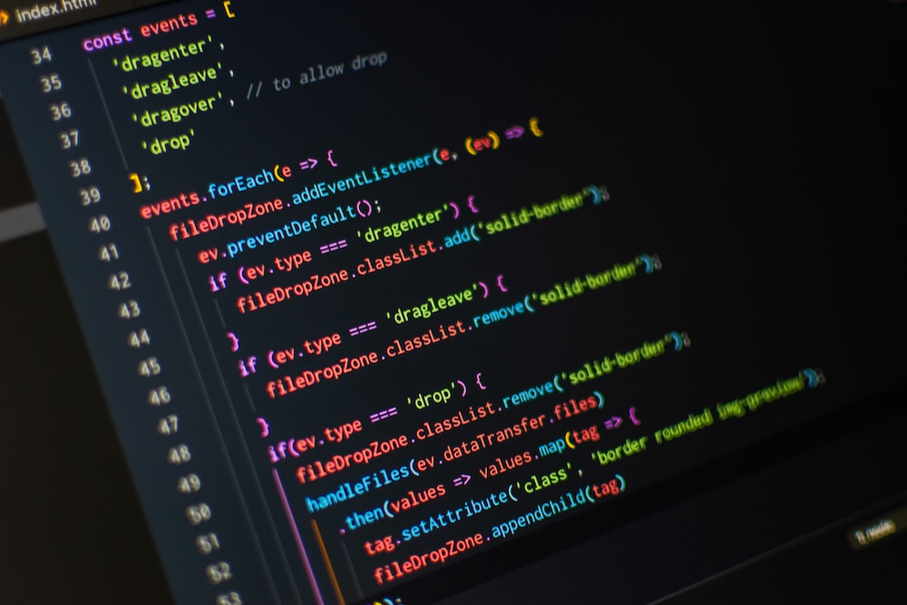
Wikipedia:
Wikipedia API for Python
Pyaudio:
It provides Python bindings for PortAudio v19, the cross-platform audio I/O library. With this, you can easily use Python to play and record audio on a variety of platforms, such as Linux, Windows, and macOS.
Selenium:
Python language bindings for Selenium WebDriver. The selenium package is used to automate web browser interaction from Python.

Slide 9

Tkinter:
It is the standard GUI library for Python. Python when combined with Tkinter provides a fast and easy way to create GUI applications. Tkinter provides a powerful object-oriented interface to the Tk GUI toolkit.
lxml:
Powerful and Pythonic XML processing library combining libxml2/libxslt with the Element Tree API
wego:
Module for weather printing format in console

Slide 10

bs4:
This is a dummy package managed by the developer of Beautiful Soup to prevent name squatting. The official name of PyPI’s Beautiful Soup Python package is beautifulsoup4. This package ensures that if you type pip install bs4 by mistake you will end up with Beautiful Soup.

Slide 11
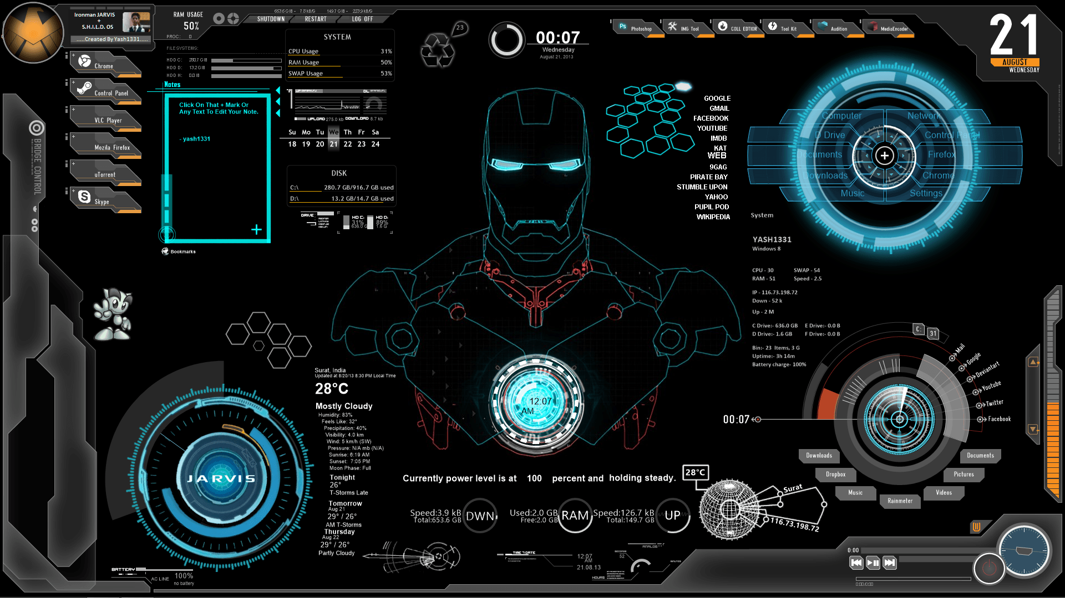
Output for each function of FRIDAY

Slide 12
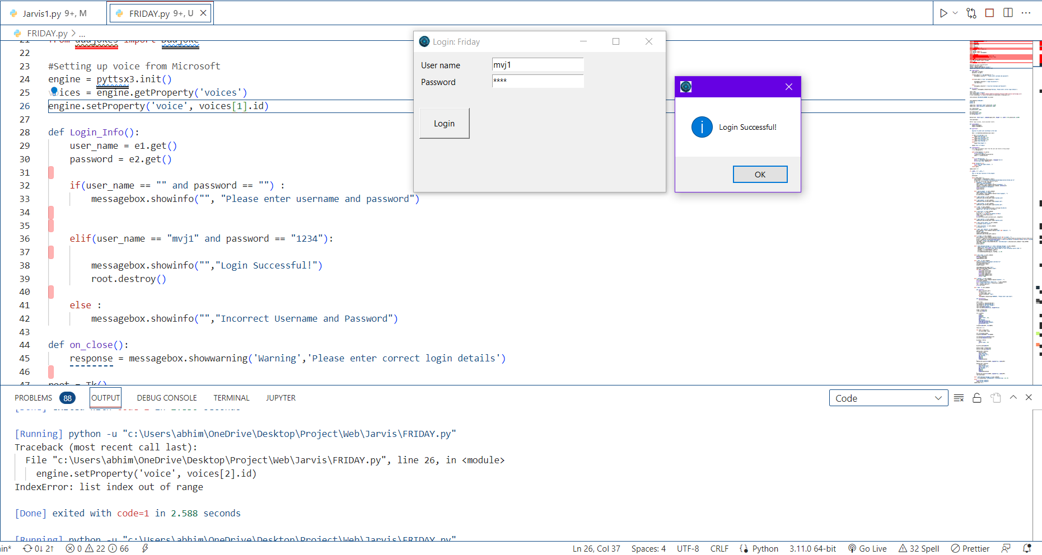
Successful Login Prompt

Slide 13
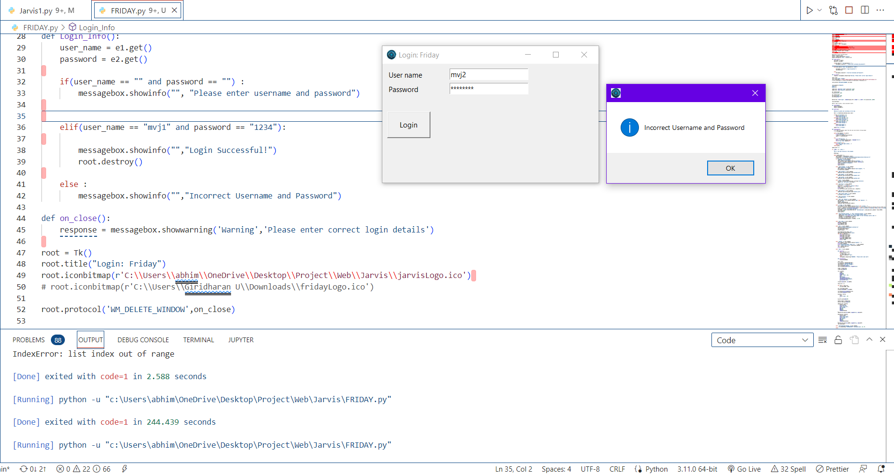
Prompt for incorrect login credentials

Slide 14
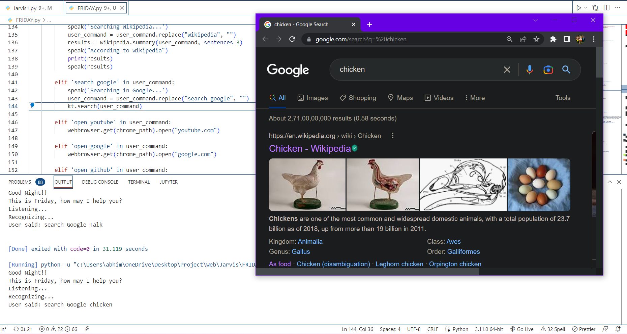
Google search function
Google search function

Slide 15
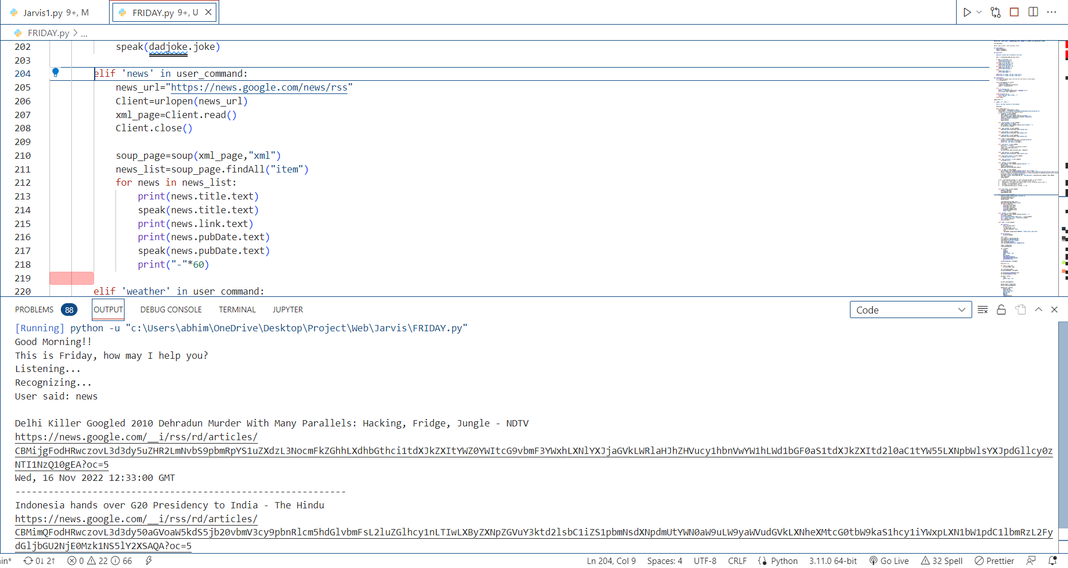
Current news function

Slide 16
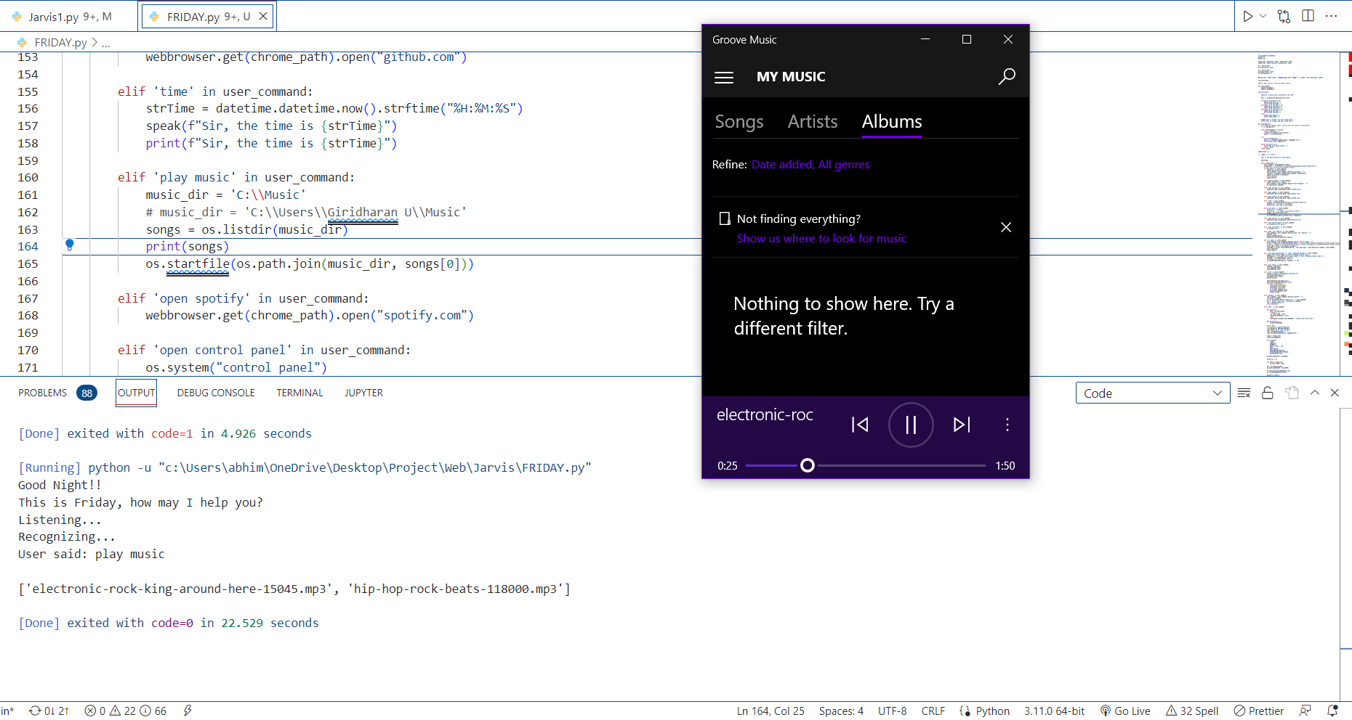
Play music function

Slide 17
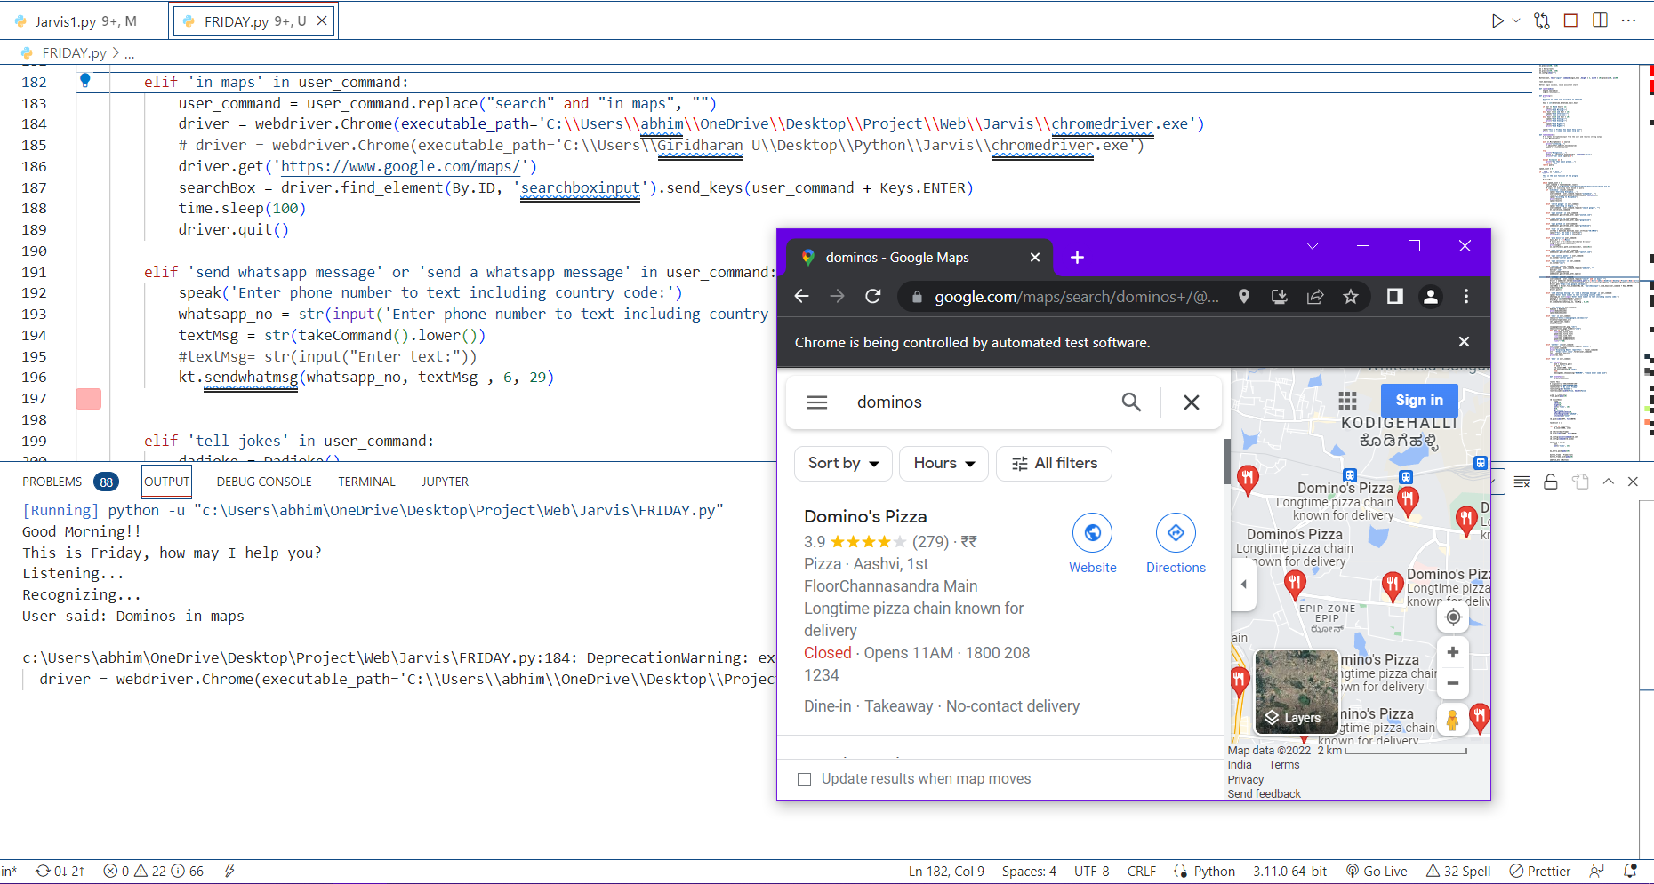
Google maps search function

Slide 18
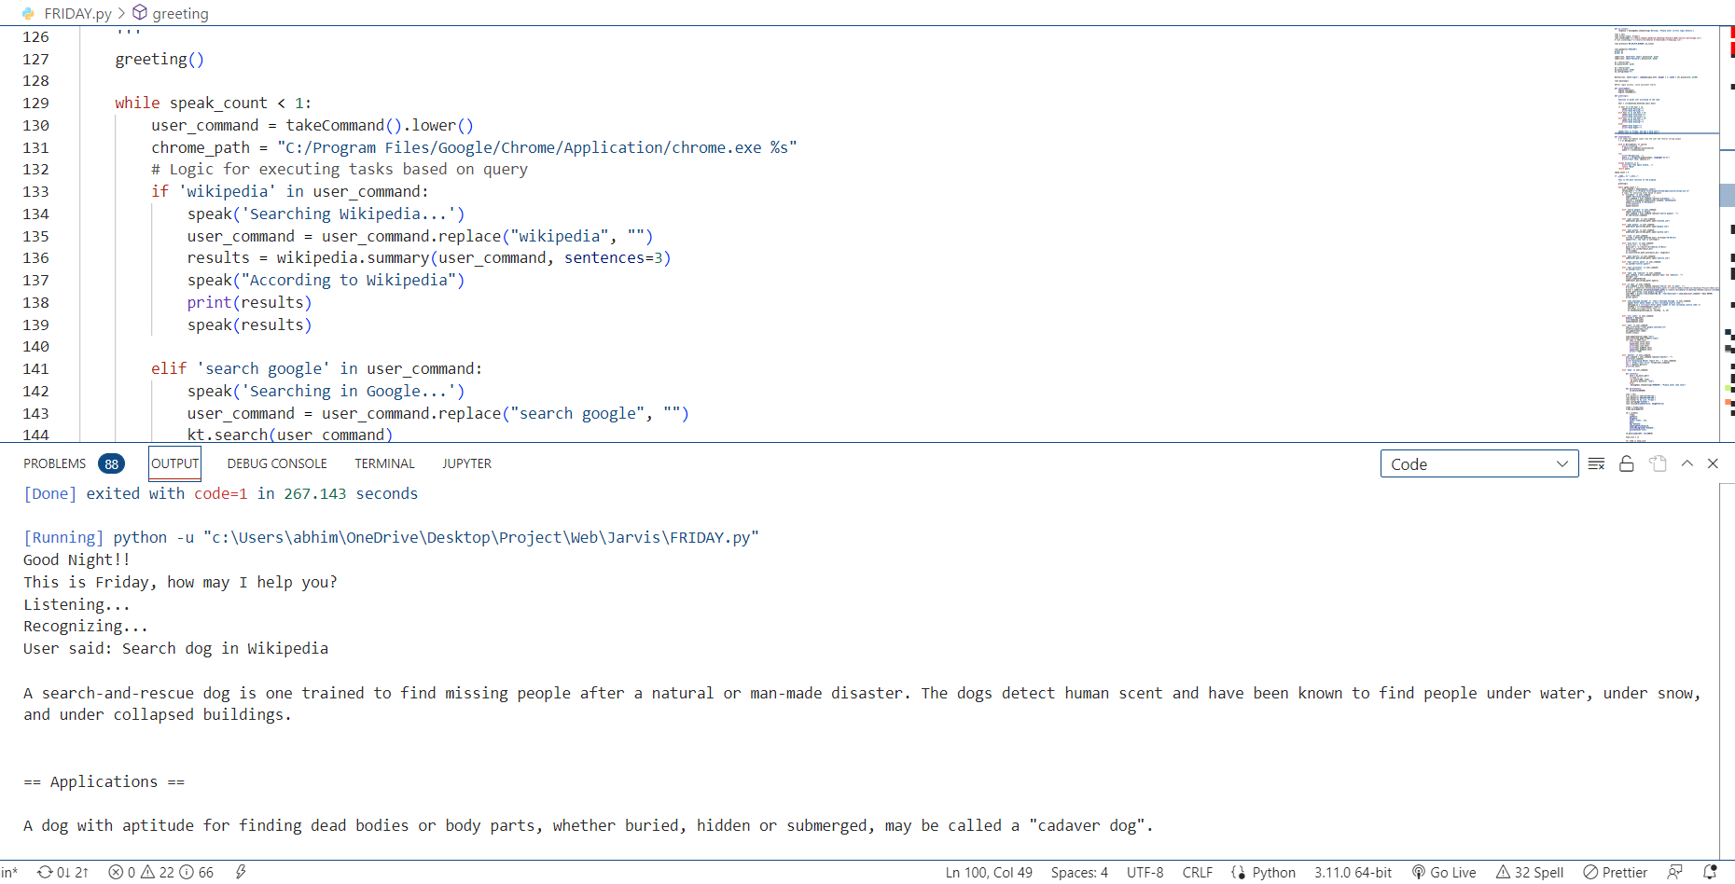
Wikipedia search function

Slide 19
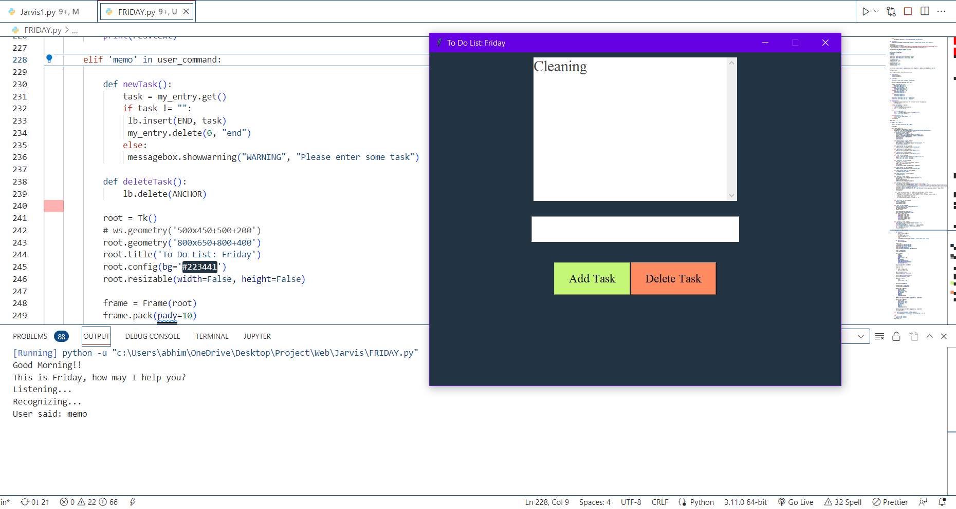
To-Do List function

Slide 20
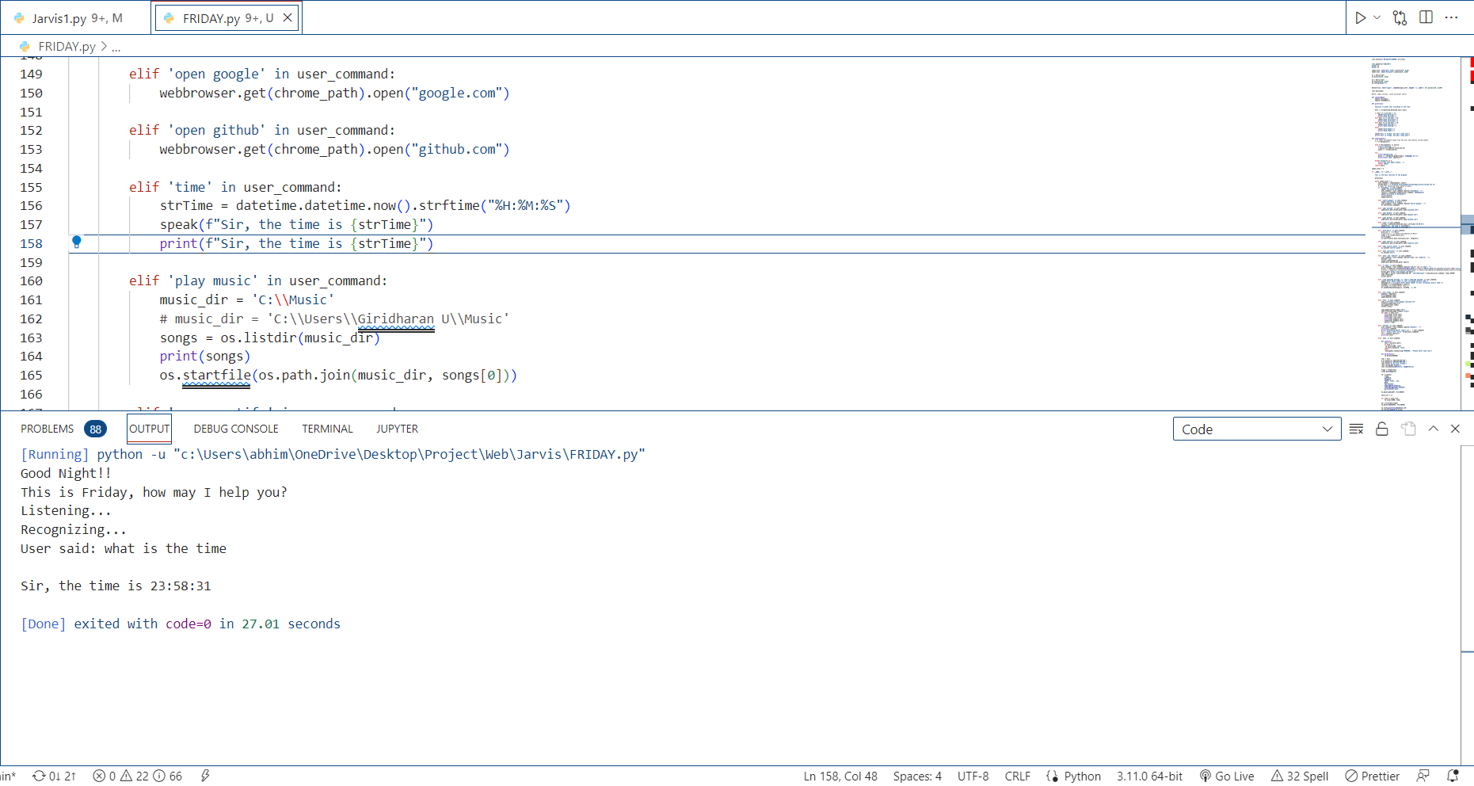
Current time display function

Slide 21
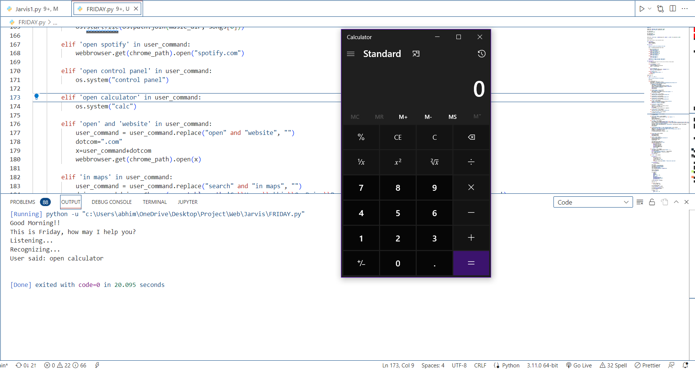
Calculator function

Slide 22
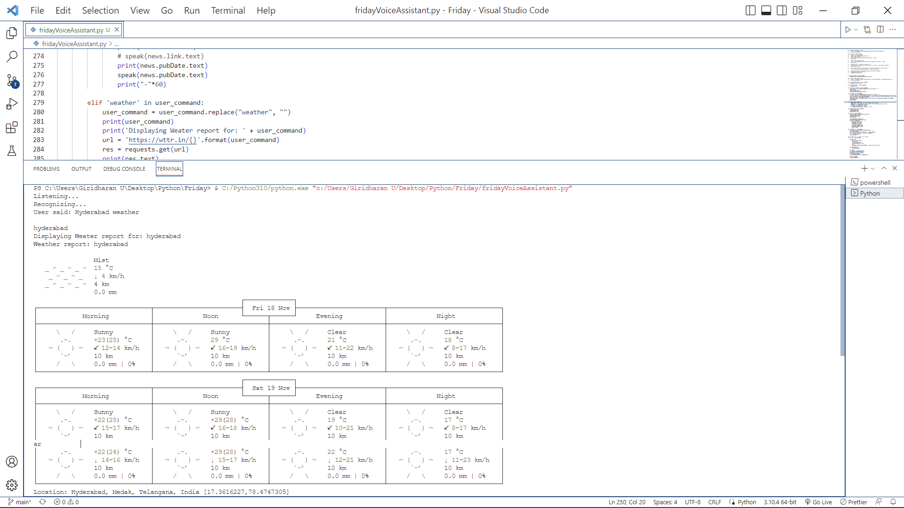
Weather report

Slide 23
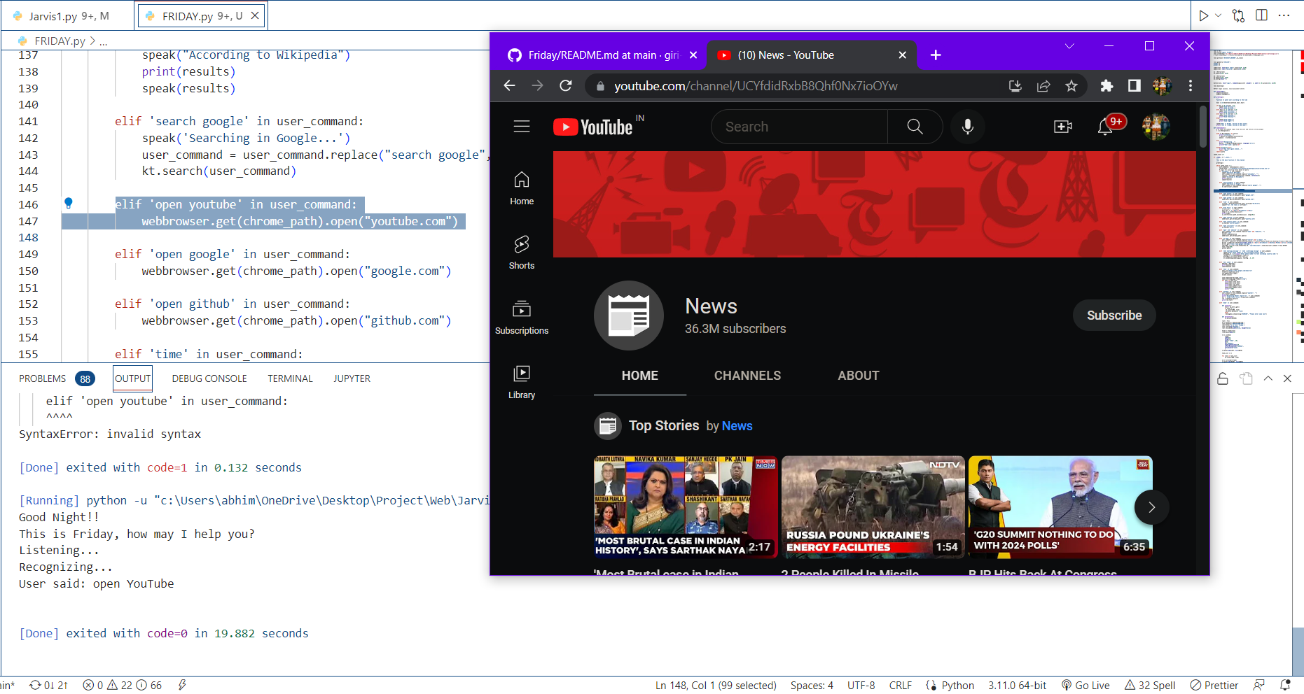
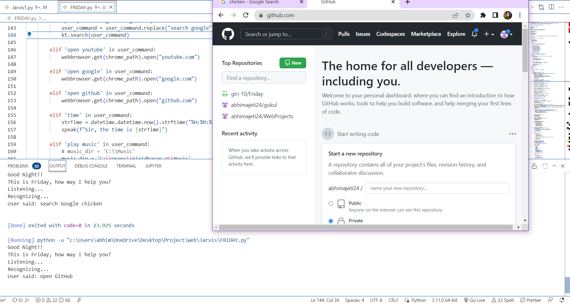
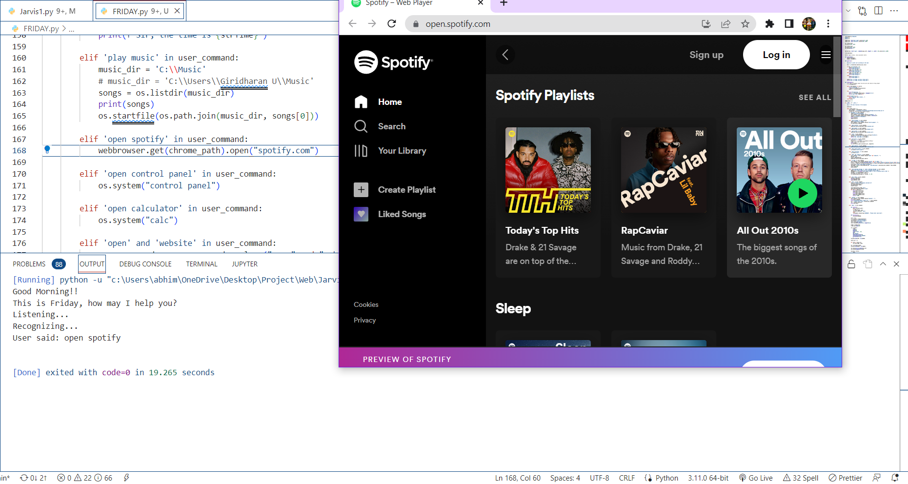
Function to open different websites (EX: Spotify, GitHub, YouTube)

Slide 24
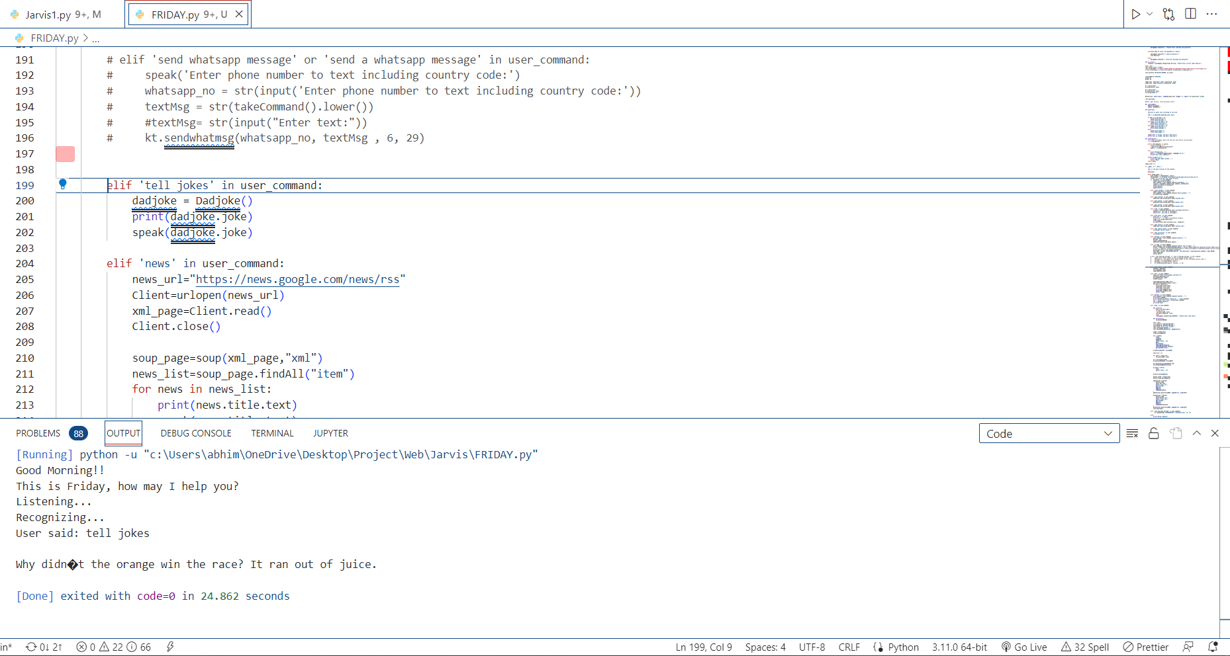
Jokes function

Slide 25
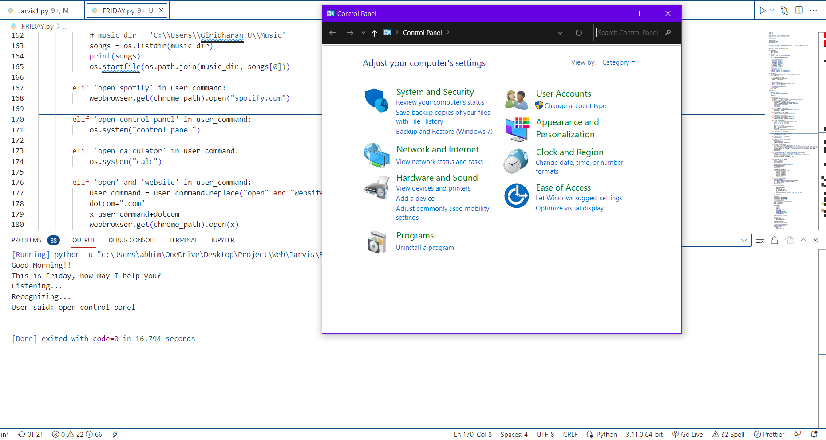
Open system control panel function

Slide 26
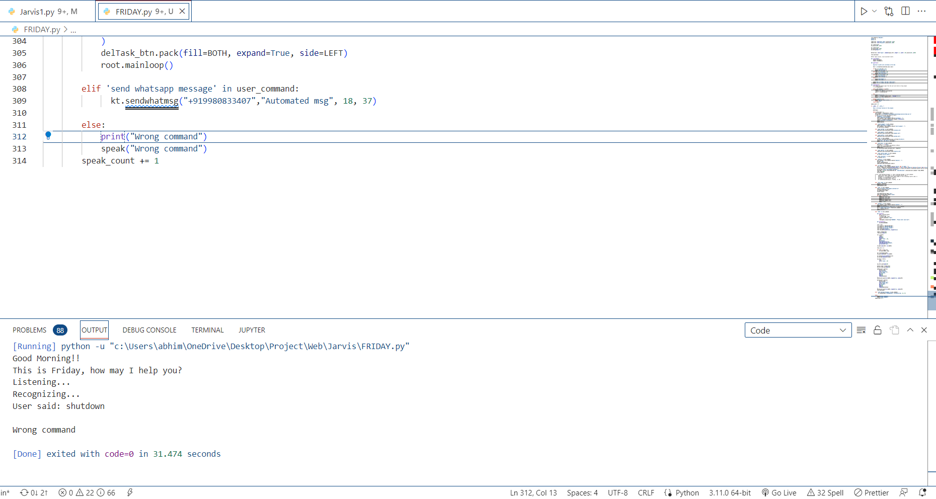
Response for invalid/wrong command

Slide 27

THANK YOU

